Slide 1
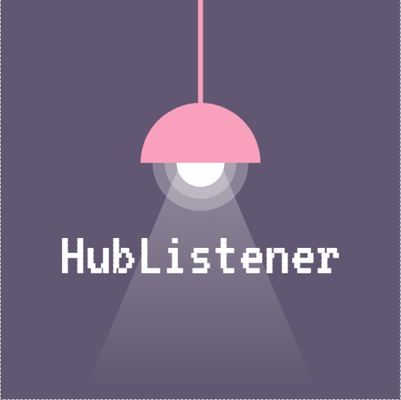

HubListener
Pedro Oliveira, Zed Ahmad, Piranaven Selva, Prakhar Jalan
Supervised by dr. smith
Notes:
- Introductions
- Mention that we are being supervised by Dr. Smith

Slide 2


Our tool : HubListener
GitHub project analysis tool
  Provides users with relevant metrics, trends, and information
  Puts the given repository against a set of the most popular projects on GitHub
Intended for project review and evaluation
  Up to the user to make any improvements or corrections based on their observations
“What specific metrics lead to success, and how do we measure this success?” - HubListener 2018
Notes:
Concise explanation on what is HubListener and how it essentially works
Can mention that this is not a serious user problem, as most GitHub projects already use a variety of other tools to evaluate their growth and track their overall progress. However, we are still providing a tool that can make it easier for a user to notice any potential patterns that could leave an impact however small (i.e. organizational changes)
Can refer to SRS for even more SPECIFIC content regarding our motivations and considerations. Here are the assumptions from our SRS (maybe make new slide for assumptions?):
There are a few factors that influence the product. The first business rule to be addressed is the amount of GitHub repositories we can clone. As we are grabbing several projects for reference directly from GitHub, we are limited to clone at a ‘reasonable’ pace. Cloning the estimated 100 repositories in parallel is not something GitHub takes lightly, as it can be detected as abusive behavior by their automated measures. Another key factor that affects this product is the specific information we will be extracting from the initial list of projects. This information can vary drastically, and so we will be selective of the types of projects gathered. To elaborate, we may only take projects created in one specific programming language to even the playing field regarding any comparisons to be made.
The initial database of projects we will use for comparison, will be that of the most popular and ‘successful’ GitHub projects
The most popular projects on GitHub contain quality code and documentation
NPM packages used as dependencies are accurate, complete and correct
Each user will have their own GitHub API Authentication token.

Slide 3

OUR Consumer audience
General consumer audience
  Any member of the open-source community (with experience using open-source software)
Example User Groups:
  Developers and Creators
  Students
  Researchers
  Companies/Organizations
  Project Managers
Notes:
Here we can talk about who we are trying to deliver this software to (potential users), and maybe why it would make sense in their hands
In the pitch examples, there’s a lot mentioned regarding the ‘customer’, but obviously in our case, fulfilling customer needs or talking about strengths/advantages of our software relative to the traditional methods of analysis may actually not work in our favor (we are inconvenient as a tool for majority of users, but we have a spot in research)

Slide 4
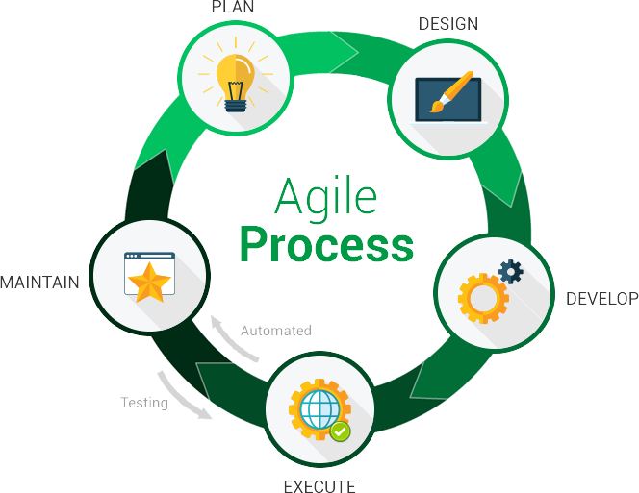


Our process
Agile approach
  GitHub issues & ZenHub for project management
  https://github.com/pjmc-oliveira/HubListener
Ongoing focus on documentation
  Development Plan, Requirements Specification, Verification & Validation, Module Diagram, detailed Onboarding plan and more…
  GitHub Wiki: Contributors Guide, Quick Start, and References
Ongoing focus on performance/optimization
  Design decision voting
  Defined the purpose and impact of these decisions
Notes:
Discuss our approach to project management, talk about how Dr. Smith was instrumental to our success/discipline in this area, design decisions, peer reviewing, task divisions, schedule (3-4 meetings a week), with bi-weekly meetings with Dr. Smith.

Slide 5
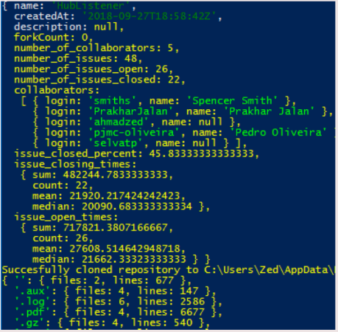
OUR First Implementation (HUBListener V1.0)
Command Line Interface
  More of a ‘hands-on’ user interaction
  …
  ...
  Requires node.js & python installed
  https://github.com/pjmc-oliveira/HubListener/wiki/Quick-Start
Cyclomatic Complexity
Cyclomatic Density
Lines of Code
Lines of Comments
Logical Lines of Code
Halstead Metric
Number of Methods
Number of Variables
Number of Issues
Number of Bugs
Number of Stars
Functional Coverage Score
Condition Coverage Score
GitHub Project Link (URL)
List of Metrics (CLI + JSON)
Notes:
NOTE: Instead of explaining both the implementations and their differences side by side, we can just briefly go over our CLI version, and then DEMO our UI implementation (talk about the convenience as we move forward in the demo)
- Ongoing -> discuss usability/features/how both are relevant in terms of uses?
- Ongoing -> Keep this one short, mostly lead this into the demo, talking about the process from version 1 to version 2 and why we even bothered doing so
- Briefly talk about our initial implementation
- Ideally we would want to talk about strengths/advantages of our software (special features here and there), but I don’t think there’s much we can ‘boast’ / highlight in general

Slide 6
DEMO (Hublistener v2.0)

Slide 7
Our perspective

Slide 8
CONclusions

